Slide 1

The Recipe for and
Damian Antonowicz

Slide 2



@D_Antonowicz

Slide 3
What is Cake?

Slide 4
What is Cake?
C# scripts!
Built on top of the Roslyn
Cross-platform
Runs on .NET, .NET Core and Mono
open source
https://github.com/cake-build/cake
https://cakebuild.net

Slide 5
What’s included?
built-in support for:
compiling code
running unit tests
file/directory operations
file compression
creating NuGet packages
many other
addins for even more!

Slide 6
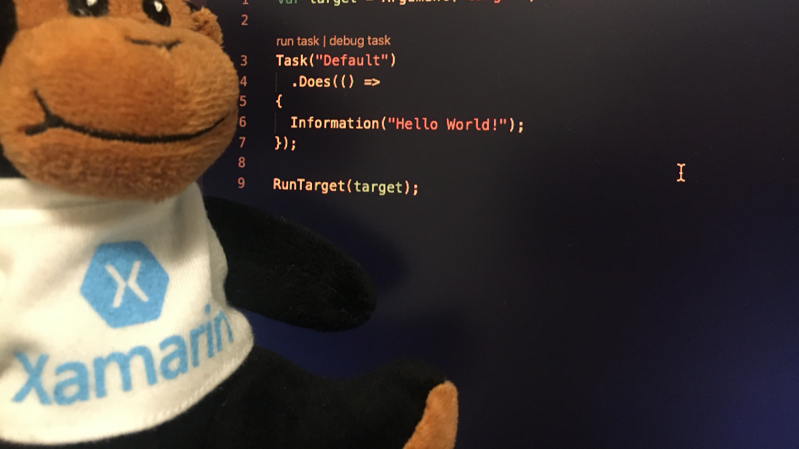
Demo

Slide 7
Why Cake?

Slide 8
Why use scripts?
time saving
less errors
repeatable
versioned

Slide 9
Why use Cake for CI / CD?
same CI / CD configuration everywhere
cross-platform
team can deploys from Windows / macOS

Slide 10

Demo

Slide 11
Thank you
https://github.com/DamianAntonowicz/CakeAndXamarinPlayground
Damian Antonowicz

